Slide 1

Techniques for Choosing Predictors
Reading: 4.2
exercises: Ch 4. 4-6
Assigned: hw 7
Producer: dr. mario
img credit: alex riegert-waters

Slide 2

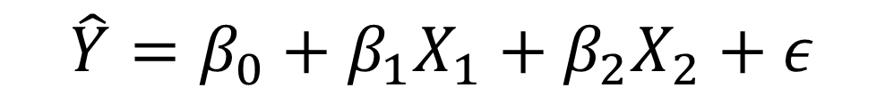
Family of Models
Consider the Linear Regression Model
Full Model: $\hat{Y}=β_{0}+β_{1}X_{1}+β_{2}X_{2}+ε$
Single Variable Model:
$\hat{Y}=β_{0}+β_{1}X_{1}+ε$
$\hat{Y}=β_{0}+β_{2}X_{2}+ε$
Empty Model: $\hat{Y}=β_{0}+ε$
$$\hat{Y}=β_{0}+β_{1}X_{1}+β_{2}X_{2}+ε$$
Which Model is Best?

Slide 3

Family of Models
When There are a Few Predictors We Can Fit All Possible Models
As k Increases, the Number of Models in the Family Increases
There are $2^{k}$Different Linear Regression Models in the Family
We Desire to Know What Predictors Need to Be Included
Bad Option: Fit Full Model and Remove Insignificant Predictors

Slide 4
Family of Models
Problem with Selecting Predictors
R-Squared Always Increases as I Add Predictors
Standard Error of Regression Always Decreases as I Add Predictors
Question: Is the Relationship Between a Predictor and the Response Variable Due to Chance or Is There an Actual Relationship?
Typically, There are Multiple Competing Models that Are All Similar
Ideally, We Want the Simplest Model that Explains the Variation in Y

Slide 5
Family of Models
Hypothetical Situation From Dataset with 100 Potential Predictors
Model 1: k=100, R-Squared = 0.90
Model 2: k=1, R-Squared = 0.89
Question: Which of These Two Models is Better?
Goal: Find the “Best” Model, but Combat “Overfitting”

Slide 6
Best Subsets
Computers are Fast = We Can Fit All Possible Models Most of the Time
Good to Start By Removing Unimportant or Correlated Predictors
Adjusted R-Squared
Accounts for the Complexity of the Model
Won’t Always Increase Just by Adding More Predictors
Find the Best Subset of Predictors that Maximizes adj R-Squared

Slide 7

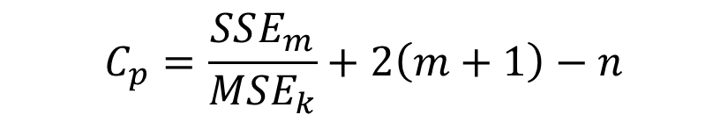
Best Subsets
Mallow’s C_{p}
Most of the Criteria Depend Only On What is in the Model
Formula:
$m=\# of Predictors in Subset Model$
$SSE_{m}=Sum of Squared Residuals of Subset Model$
$MSE_{k}=Mean Squared Error from Full Model$
Find the Best Subset of Predictors that Minimizes Mallow’s C_{p}
$$C_{p}=\frac{SSE_{m}}{MSE_{k}}+2\left(m+1\right)−n$$

Slide 8
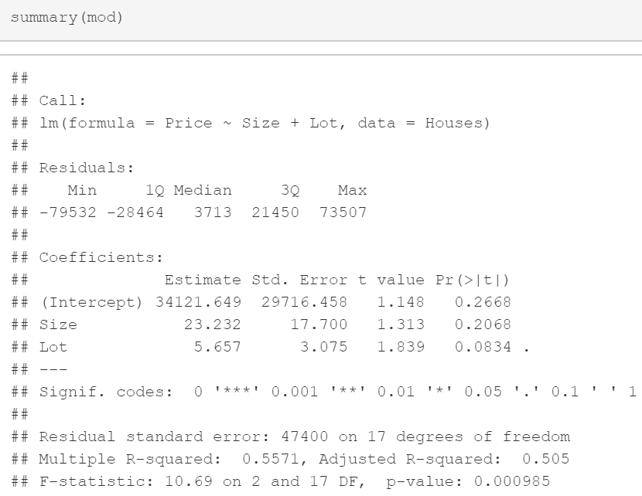
Example: Predicting Price of Home
Are You Surprised?

Slide 9
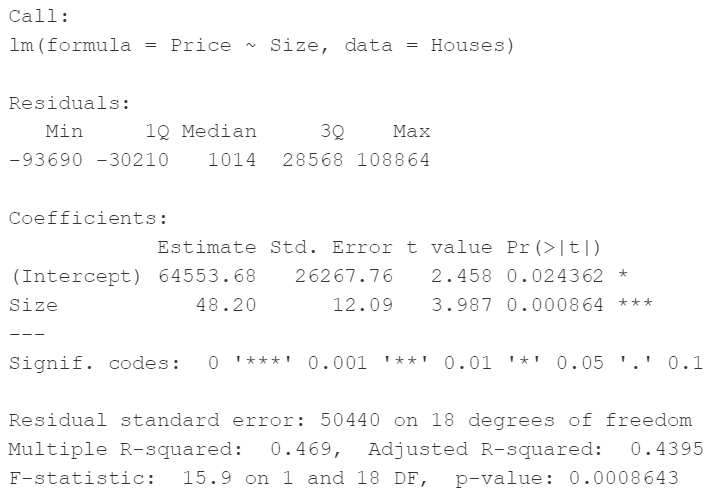
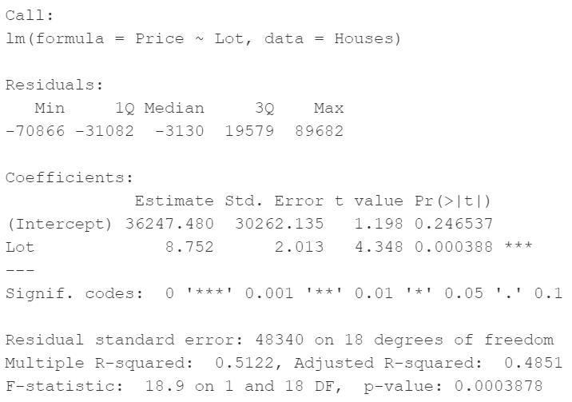
Example: Predicting Price of Home

Slide 10
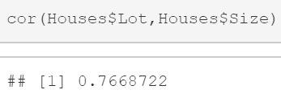
Example: Predicting Price of Home
The Correlation between Lot and Size is relatively high

Slide 11
Multicollinearity
A Set of Predictors Exhibits Multicollinearity when One or More of the Predictors is Strongly Correlated with Some Combination of the Other Predictors in the Set
According to Statology.org, Strong Correlation is Greater than 0.75
This is One Challenge in Dealing with Multiple Predictors
If the One of the Predictors is Perfectly Correlated with Another Predictor, then There is No Unique Solution in Linear Regression

Slide 12
Multicollinearity
The Individual t-Test Assesses How Much a Predictor Contributes to the Model After Accounting for the Other Predictors
When Two Predictor Variables are Individually Important but Highly Correlated, They Both Don’t Need to be in the Model Together
If They are Both Included, R-Squared will be Moderately Improved and Adjusted R-Squared could Possibly Get Worse

Slide 13
Detecting Multicollinearity
Correlation Matrix: Calculates the Correlation Between Every Pair of Predictor Variables
Scatterplots: Create a Scatterplot for Every Pair of Predictor Variables
We Wouldn’t Know if We had a Predictor that Was Highly Associated with a Combination of Predictors
Example:
$$\hat{Grade}=β_{0}+β_{1}\left(Grade on M1\right)+β_{2}\left(Grade on M2\right)+β_{3}\left(Average M Grade\right)+ε$$

Slide 14

Detecting Multicollinearity
Fit Linear Regressions Where Each Predictor Acts as a Response Variable
Estimate R-Squared for Each of These Linear Regressions
Variance Inflation Factor:
Rule of Thumb: Bad VIF is Greater Than 5 (R-Squared > 0.8)
$$VIF_{i}=\frac{1}{1−R_{i}^{2}}$$

Slide 15
Handling Multicollinearity
Option 1: Drop Some Predictors
Check to See if R-Squared Drops Drastically
Examine Effect on Residuals and Model Assumptions
Option 2: Combine Some of the Predictors
Average or Sum of Groups of Predictors (Example: Survey)
Option 3: Interpret Coefficients and t-Tests with Caution
Option 4: Use Stepwise Algorithms (4.2) or Cross-Validation (4.3)

Slide 16
Thank You
Make Reasonable Decisions

